Slide 1


Dave C. LeFevre
April 14, 2022

Slide 2

Outline
Executive Summary
Introduction
Methodology
Results
Conclusion
Appendix

Slide 3
Executive Summary
Summary of methodologies
Collection of data about Space X missions from public sources
Wrangling the data gathered for exploratory analysis
Creation of visualizations to better explore the Space X data
Creation of a model to help determine optimal conditions for Space Y missions
Summary of all results
Through public data we can create a model that will allow us to determine the best conditions for recovery allowing us to save money on rocket operations.

Slide 4
Introduction
Project background and context:
At Space Y we aim to be the leading provider of space transport within the next 10 years. To do this we must have an idea of what ways we bring payload to orbit with less cost.
Problem we want an answer to:
How can we predict the optimal conditions in which to launch payload that allow us to have the most successful missions and to recover costly first stage rockets.

Slide 5

Section 1

Slide 6
Methodology
Executive Summary
Data collection methodology
Data was collected from public available sources, including the Space X data API and open sources such as Wikipedia.
Clean and wrangle the data from our sources into a useful data set for numerical analysis.
Problem we want an answer to:
How can we predict the optimal conditions in which to launch payload that allow us to have the most successful missions and to recover costly first stage rockets.

Slide 7
Methodology
Executive Summary
Perform exploratory data analysis (EDA) using visualization and SQL
Perform interactive visual analytics using Folium and Plotly Dash
Perform predictive analysis using classification models
Using our data we created training sets to try with various methods of Logistical regression. After testing the accuracy of thesemethods with test data we chose a model that would help us findthe most economical conditions to launch rockets.

Slide 8
Data Collection
Data was collected from two sources:
The Space X API’s interface for rocket data
https://api.spacexdata.com/v4/rockets/
Wikipedia pages on Space X launches
https://en.wikipedia.org/wiki/List_of_Falcon_9_and_Falcon_Heavy_launches

Slide 9
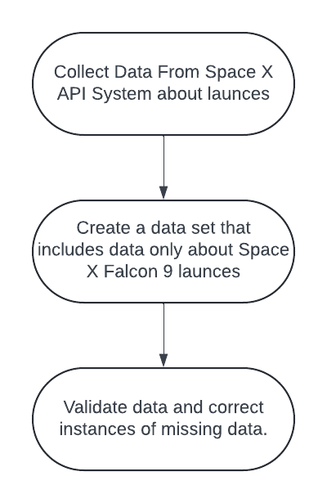
Data Collection – SpaceX API
The Space X web site allows for download of publicly available data. We used their API to import this data into datasets.
Notebook with SpaceX API data collection: https://github.com/dcl-coursera/data_science_capstone/blob/main/01-jupyter-labs-spacex-data-collection-api.ipynb
`

Slide 10
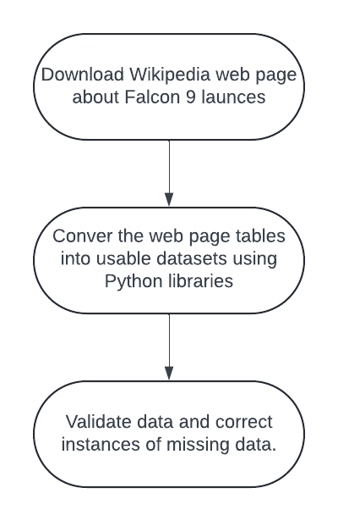
Data Collection - Scraping
Wikipedia also collects all publicly known data about Falcon 9 launches. This data was downloaded an put into an form that can be analyzed.
Notebook with web scraping data collection: https://github.com/dcl-coursera/data_science_capstone/blob/main/02-jupyter-labs-webscraping.ipynb

Slide 11
Data Wrangling
When combining and comparing the data from the two sources we:
Calculated the number of launches on each site.
Calculated the number and occurrence of each orbit
Calculate the number and occurrence of mission outcome of the orbits
Create a table of landing outcomes to allow for mathematical analysis
Notebook with Data Wrangling: https://github.com/dcl-coursera/data_science_capstone/blob/main/03-labs-jupyter-spacex-Data%20wrangling.ipynb

Slide 12
EDA with Data Visualization
We explored the Data with the following plots:
Flight number vs. Launch Site
Payload vs. Launch Site
Success Rate vs. Orbit Type
Flight Number vs. Orbit Type
Payload vs. Orbit Type
Launch Success Yearly Trend
Notebook with Data Visualization EDA:https://github.com/dcl-coursera/data_science_capstone/blob/main/05-jupyter-labs-eda-dataviz.ipynb

Slide 13
EDA with SQL
Using SQL we found answers to some questions:
Find the names of the unique launch sites
Find 5 records where launch sites begin with `CCA`
Calculate the total payload carried by boosters from NASA
Calculate the average payload mass carried by booster version F9 v1.1
Find the dates of the first successful landing outcome on ground pad
List the names of boosters which have successfully landed on drone ship and had payload mass greater than 4000 but less than 6000
Calculate the total number of successful and failure mission outcomes

Slide 14
EDA with SQL
Using SQL we found answers to some questions (continued):
List the names of the booster which have carried the maximum payload mass
List the landing_outcomes in drone ship, their booster versions, and launch site names for in year 2015
Rank the count of landing outcomes (such as Failure (drone ship) or Success (ground pad)) between the date 2010-06-04 and 2017-03-20, in descending order
Notebook with SQL-based EDA:https://github.com/dcl-coursera/data_science_capstone/blob/main/04-jupyter-labs-eda-sql-coursera_sqllite.ipynb

Slide 15
Build an Interactive Map with Folium
Groups were added to a map to show all launch sites. Individual launch areas are indicated in these groups.
Individual success and failures are indicated on the map to visually see the record of each area.
Lines are added on the maps to show proximity to coasts and other map lines for an indication of what areas may work best for flights.
Notebook with Folium Map: https://github.com/dcl-coursera/data_science_capstone/blob/main/06-lab_jupyter_launch_site_location%20.ipynb

Slide 16
Build a Dashboard with Plotly Dash
A dashboard was built to show the percentages of successful launches per all four sites as well as the percentages of successful vs. unsuccessful launches at each site.
To show the relationship between payload weights and mission success an interactive scatter plot is included. The plot has a slider to see how the plot changes vs. different ranges of payload weights and be viewed for each selected launch site as well as for all launches as a whole.
This combination allows for checks to see what sites and payload weight combinations work best for mission success.
Source code of Plotly Dash dashboard: https://github.com/dcl-coursera/data_science_capstone/blob/main/07-spacex_dash_app.py

Slide 17
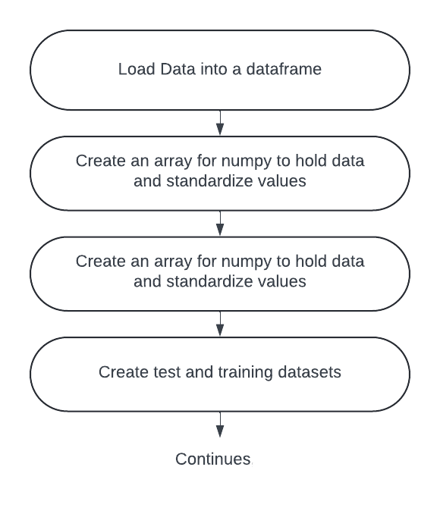
Predictive Analysis (Classification)

Slide 18
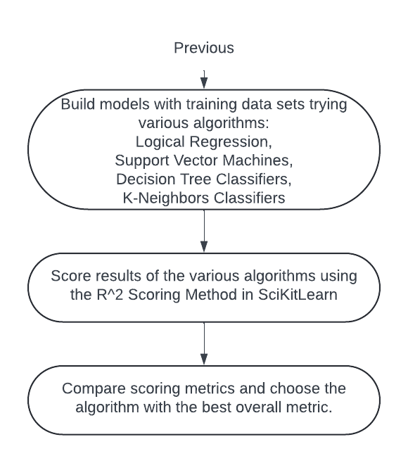
Predictive Analysis (Classification)

Slide 19
Predictive Analysis (Classification)
Notebook with Predictive Analysis: https://github.com/dcl-coursera/data_science_capstone/blob/main/08-SpaceX_Machine%20Learning%20Prediction_Part_5%20(copy).ipynb

Slide 20

Section 2

Slide 21
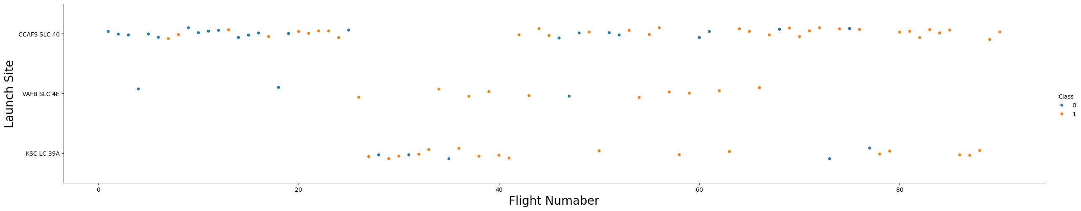
Flight Number vs. Launch Site
.
We see that different launch sites have different success rates. CCAFS LC-40, has a success rate of 60 %, while KSC LC-39A and VAFB SLC 4E has a success rate of 77%.

Slide 22
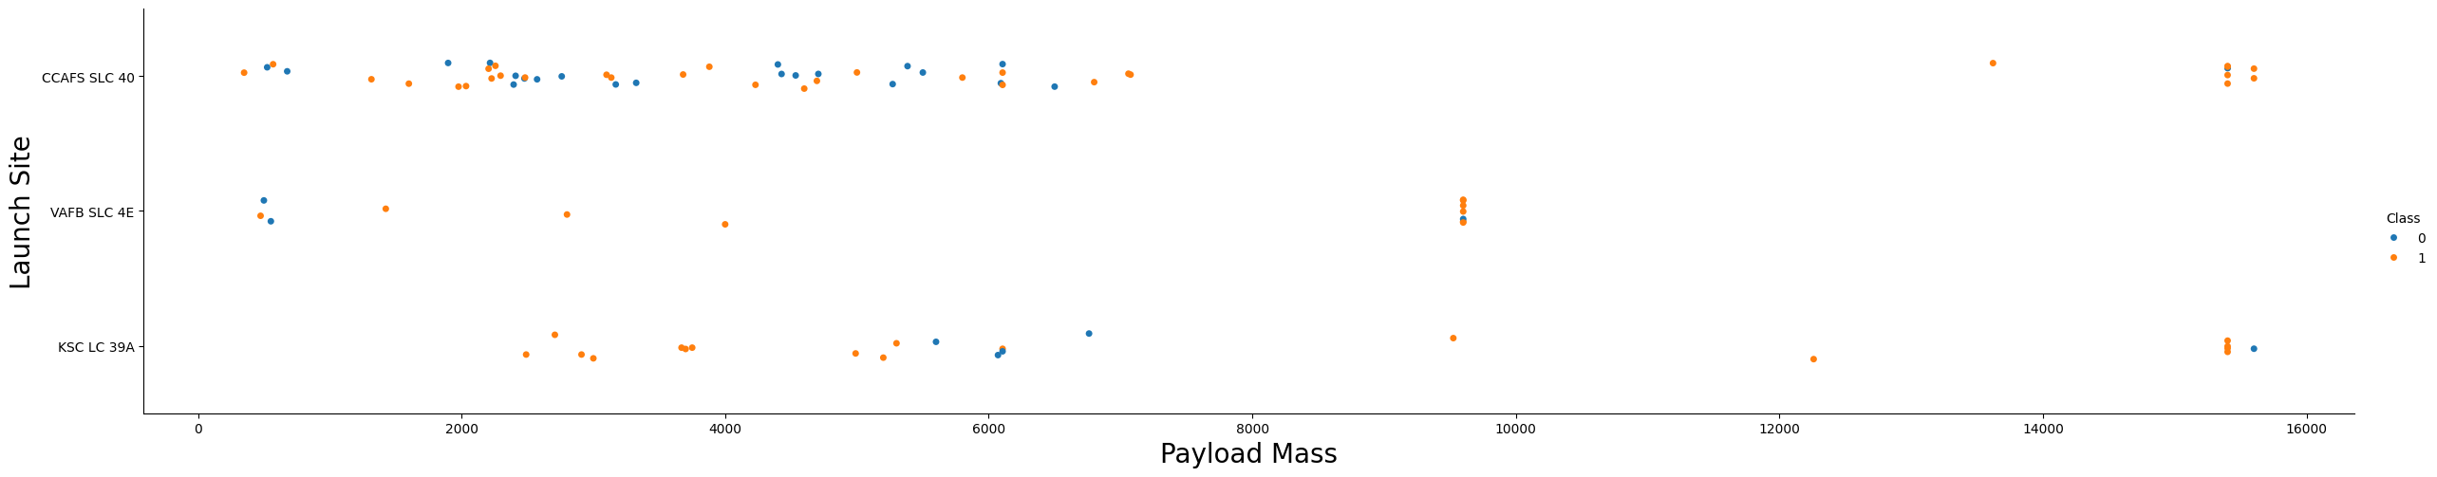
Payload vs. Launch Site
For the VAFB-SLC launchsite there are no rockets launched for heavy payload mass(greater than 10000).

Slide 23
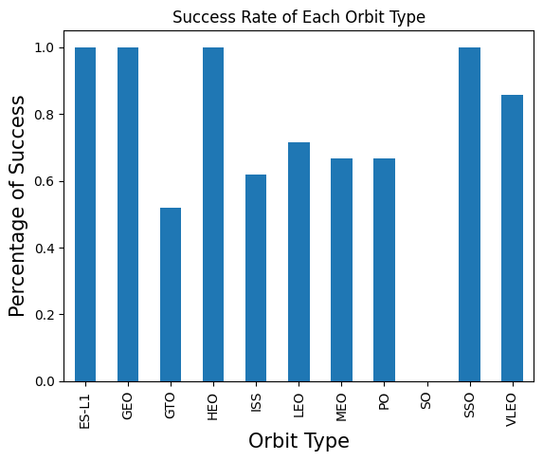
Success Rate vs. Orbit Type
Several orbits have perfect success rates. These are ES-L1, GEO, HEO, and SSO. VLEO also have very high success rates.

Slide 24
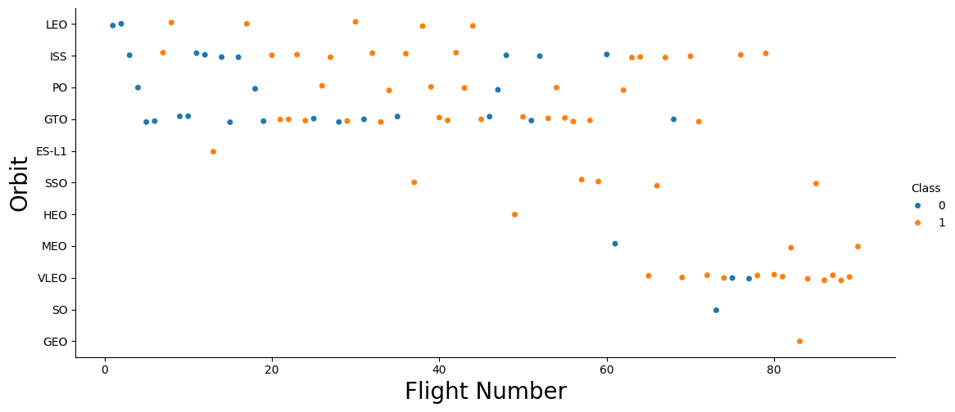
Flight Number vs. Orbit Type
In the LEO orbit the Success appears related to the number of flights; however there seems to be no relationship between flight number when in GTO orbit.

Slide 25
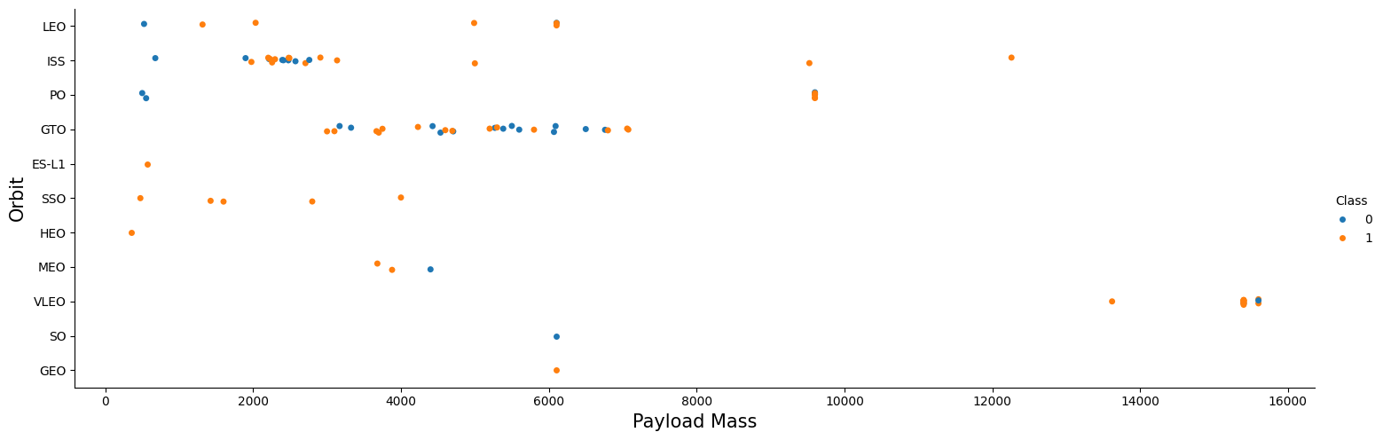
Payload vs. Orbit Type
With heavy payloads the successful landing or positive landing rate are more for Polar,LEO and ISS. However for GTO we cannot distinguish this well as both positive landing rate and negative landing(unsuccessful mission) are both there here.

Slide 26
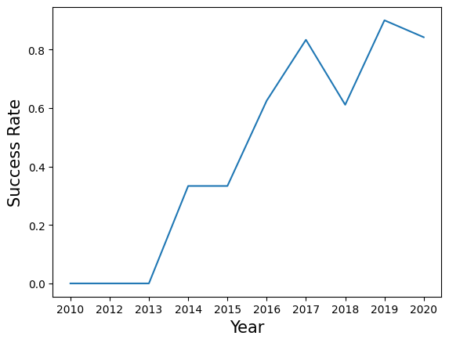
Launch Success Yearly Trend
The success rate since 2013 kept increasing till 2017 (stable in 2014) and after 2015 it started increasing. The percentage of successful missions increases with the experience of the crew and the company.

Slide 27
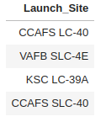
All Launch Site Names
Find the names of the unique launch sites
SELECT DISTINCT("Launch_Site") FROM SPACEXTABLE

Slide 28
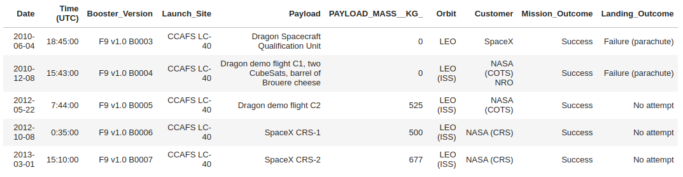
Launch Site Names Begin with 'CCA'
Find 5 records where launch sites begin with `CCA`
SELECT * FROM SPACEXTABLE WHERE "Launch_Site" like "CCA%" LIMIT 5

Slide 29
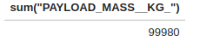
Total Payload Mass
Calculate the total payload carried by boosters from NASA
SELECT sum("PAYLOAD_MASS__KG_") FROM SPACEXTABLE WHERE "Customer" like "NASA%"

Slide 30
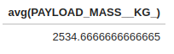
Average Payload Mass by F9 v1.1
Calculate the average payload mass carried by booster version F9 v1.1
SELECT avg(PAYLOAD_MASS__KG_) FROM SPACEXTABLE WHERE "Booster_Version" like "F9 v1.1%"

Slide 31
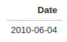
First Successful Ground Landing Date
Find the dates of the first successful landing outcome on ground pad
SELECT Date FROM SPACEXTABLE WHERE Mission_Outcome="Success" ORDER BY Date LIMIT 1

Slide 32
Successful Drone Ship Landing with Payload between 4000 and 6000
List the names of boosters which have successfully landed on drone ship and had payload mass greater than 4000 but less than 6000
SELECT DISTINCT(Booster_Version) FROM SPACEXTABLE WHERE Mission_Outcome="Success" and "PAYLOAD_MASS__KG_" > 4000 and "PAYLOAD_MASS__KG_" < 6000
These boosters: F9 v1.1, F9 v1.1 B1011, F9 v1.1 B1014, F9 v1.1 B1016, F9 FT B1020, F9 FT B1022, F9 FT B1026, F9 FT B1030, F9 FT B1021.2, F9 FT B1032.1, F9 B4 B1040.1, F9 FT B1031.2, F9 FT B1032.2, F9 B4 B1040.2, F9 B5 B1046.2, F9 B5 B1047.2, F9 B5 B1048.3, F9 B5 B1051.2, F9 B5B1060.1, F9 B5 B1058.2, F9 B5B1062.1

Slide 33
Total Number of Successful and Failure Mission Outcomes
Calculate the total number of successful and failure mission outcomes
SELECT COUNT(Date) FROM SPACEXTABLE WHERE Mission_Outcome="Success"
Success: 98
SELECT COUNT(Date) FROM SPACEXTABLE WHERE Mission_Outcome !="Success"
Fail: 3

Slide 34
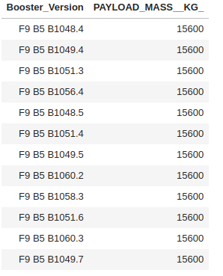
Boosters Carried Maximum Payload
List the names of the booster which have carried the maximum payload mass
SELECT Booster_Version, "PAYLOAD_MASS__KG_" FROM SPACEXTABLE WHERE "PAYLOAD_MASS__KG_" = (SELECT MAX("PAYLOAD_MASS__KG_") FROM SPACEXTABLE)

Slide 35
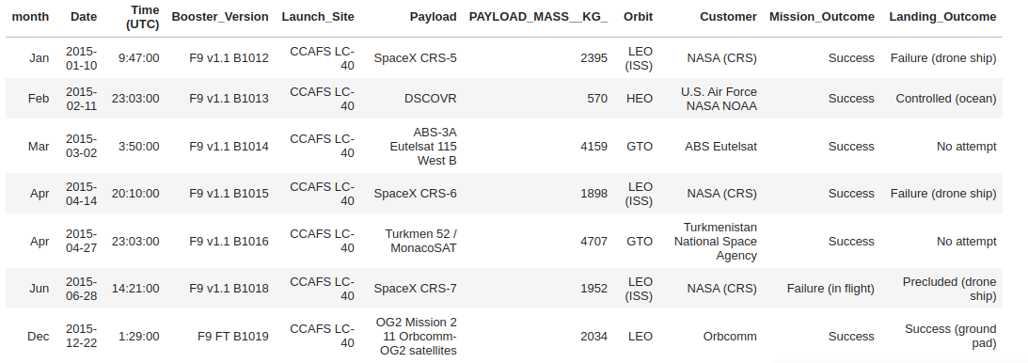
2015 Launch Records
SELECT substr ("--JanFebMarAprMayJunJulAugSepOctNovDec", strftime ("%m", Date) * 3, 3) as month, * FROM SPACEXTABLE WHERE substr(Date,0,5)='2015'

Slide 36
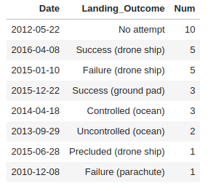
Rank Landing Outcomes Between 2010-06-04 and 2017-03-20
Rank the count of landing outcomes (such as Failure (drone ship) or Success (ground pad)) between the date 2010-06-04 and 2017-03-20, in descending order SELECT Date, Landing_Outcome, Count(Landing_Outcome) Num from SPACEXTABLE WHERE Date > "2010-06-04" AND Date < "2017-03-20" GROUP BY Landing_Outcome ORDER by Num Desc

Slide 37

Section 3

Slide 38
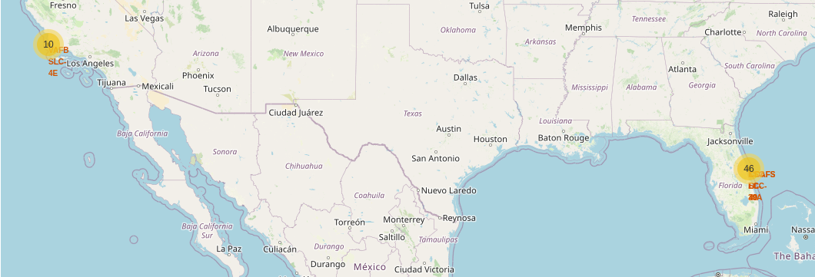
Folium map of launch site locations

Slide 39
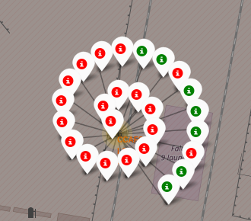
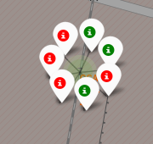
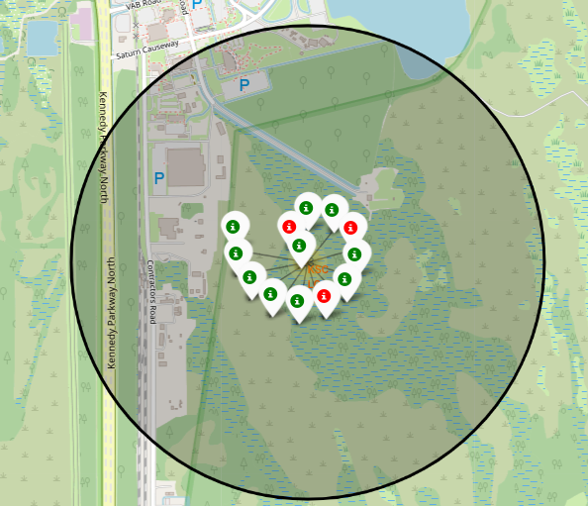
Maps of Successful and failed launches
Successful and Failed Launches in Florida:

Slide 40
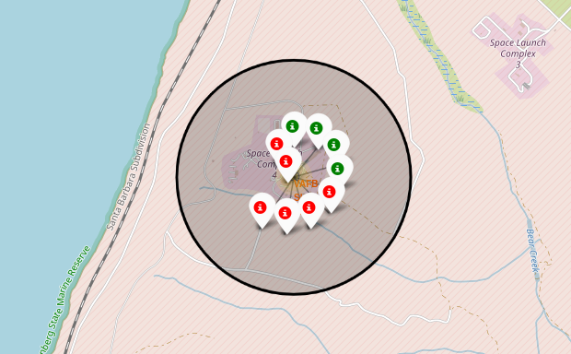
Maps of Successful and failed launches
Successful and Failed Launches in California:

Slide 41
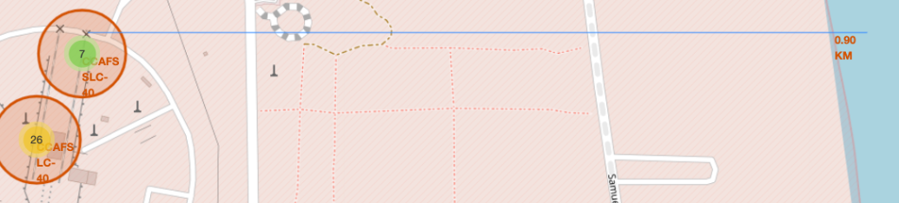
Folium map of proximity to the coast

Slide 42

Section 4

Slide 43
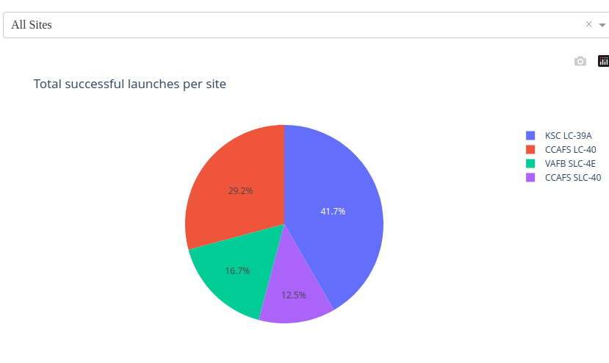
Total Successful Launches for All Sites

Slide 44
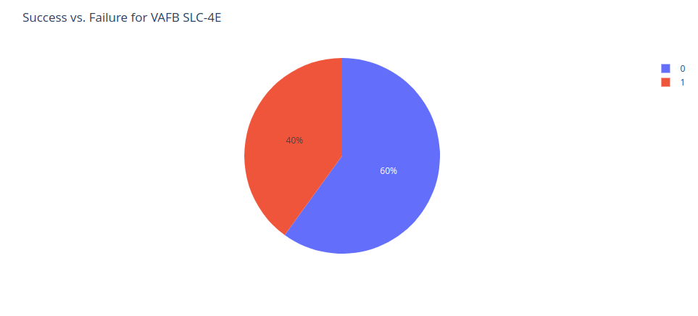
Highest Launch Success Ratio

Slide 45
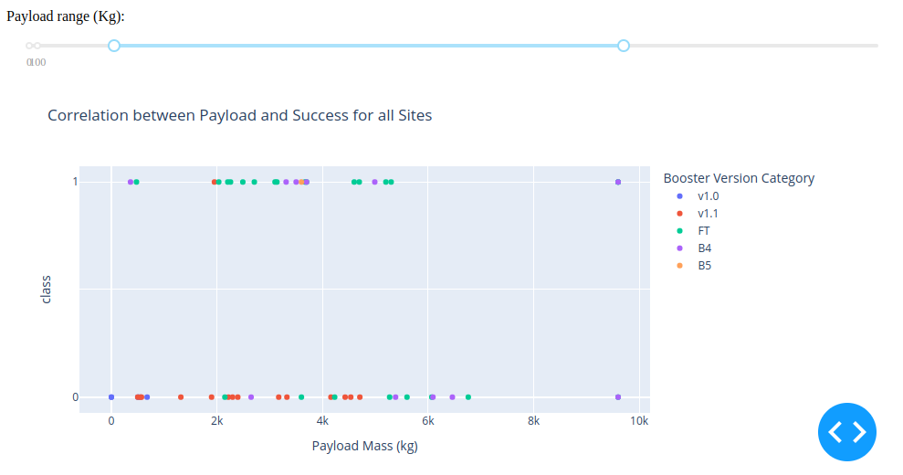
Payload vs. Launch for all sites

Slide 46

Section 5

Slide 47
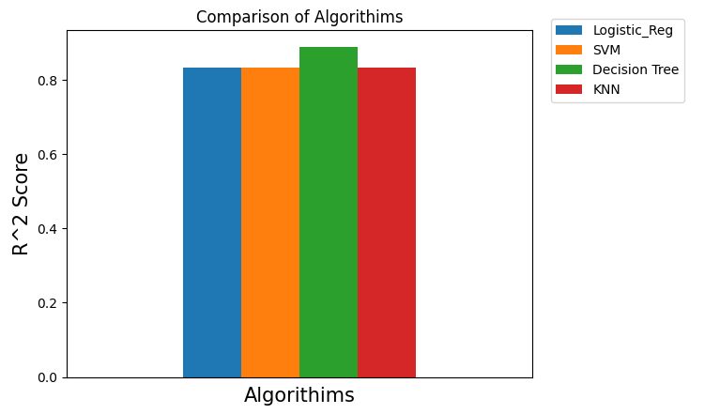
Classification Accuracy

Slide 48
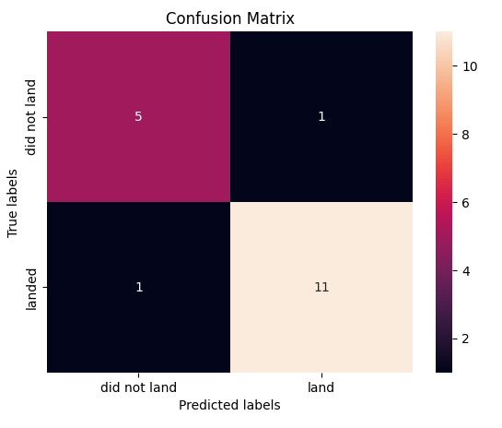
Confusion Matrix
Confusion Matrix was best for the Decision Tree Algorithm, showing only 1 false positive and 1 false negative.

Slide 49
Conclusions
The strongest algorithm for predictive analysis for mission success is the Decision Tree Algorithm.
Successful launches and recoveries depend greatly on the size of the payload. Smaller payloads have greater success. Larger payloads work best a small number of launch sites.
The success of missions improves as time passes and crews and companies have more experience.
Site KSC-LC-39A has the best overall performance.
ES11, GEO, HEO, and SSO orbit types have perfect performance records.

Slide 50


